Slide 1
Capstone Project
Netflix movies & TV shows clustering by: Manisha Dhanuka

Slide 2
What to expect in next few slides:
Problem Statement
Data overview
Data Cleaning & Feature engineering
Exploratory Data Analysis
Feature Selection
Text pre-processing
Tf-idf Vectorizer
Nearest Neighbors model
Spectral Clustering
Conclusion

Slide 3

Problem Statement:
The dataset consists of tv shows and movies available on Netflix as of 2019. The dataset is collected from Flixable which is a third-party Netflix search engine. In 2018, they released an interesting report which shows that the number of TV shows on Netflix has nearly tripled since 2010. The streaming service’s number of movies has decreased by more than 2,000 titles since 2010, while its number of TV shows has nearly tripled. It will be interesting to explore what all other insights can be obtained from the same dataset.

Slide 4
Data Overview:
1. show_id : Unique ID for every Movie / Tv Show
2. type : Identifier - A Movie or TV Show
3. title : Title of the Movie / Tv Show
4. director : Director of the Movie
5. cast : Actors involved in the movie / show
6. country : Country where the movie / show was produced
7. date_added : Date it was added on Netflix
8. release_year : Actual Release year of the movie / show
9. rating : TV Rating of the movie / show
10. duration : Total Duration - in minutes or number of seasons
11. listed_in : Genere
12. description: The Summary description

Slide 5
Data Cleaning & Feature Engineering:
Handled null values: Most of the null values were in the text based features which cannot be imputed thus replace those with ‘Unavailable’ and deleted those rows where date added was not given.
No Duplicates were found.
There was some discrepancy in data, for some records date added was earlier than date released. Drop those data values.
Later pre-process the data. There were multiple countries, cast, genre for a given row. Convert them into list so that we can use them later for further insights.

Slide 6
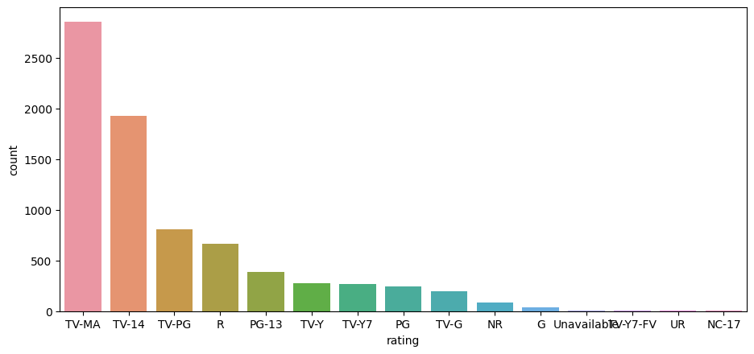
Analysing the content w.r.t TV Ratings:
To analyze the type of content available on Netflix to know if it caters to the entertainment need of all beyond the age factor or this is specific to some age group. It seems very less content is available for the kids. Most of them are meant for adult audience or required parent's presence.

Slide 7
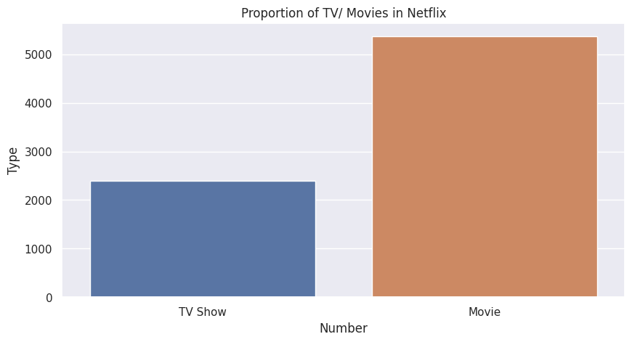
Is Netflix has increasingly focusing on TV rather than movies in recent years?
Movies are doubled the amount of Tv shows on the platform.

Slide 8
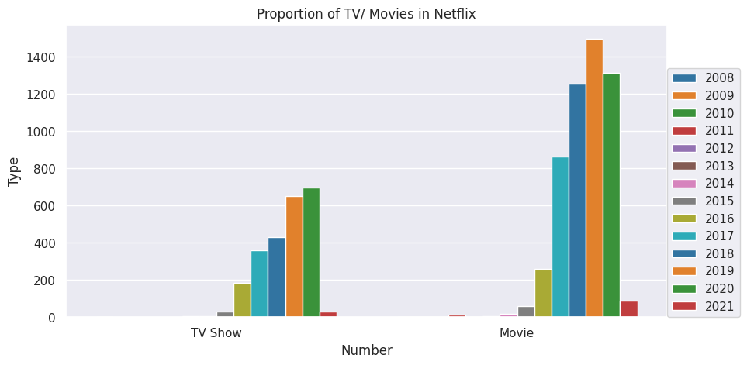
Tv/movie proportion over the years:

Slide 9
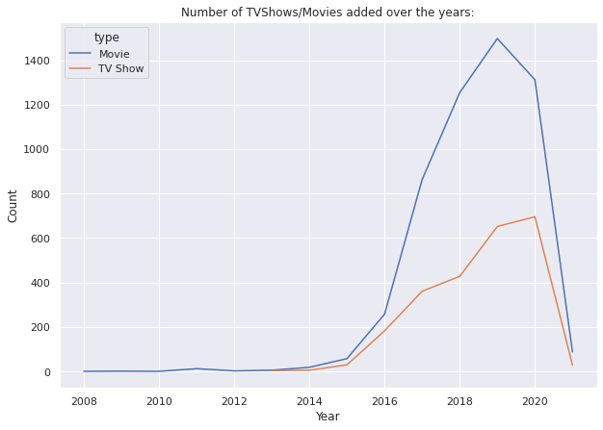

Slide 10
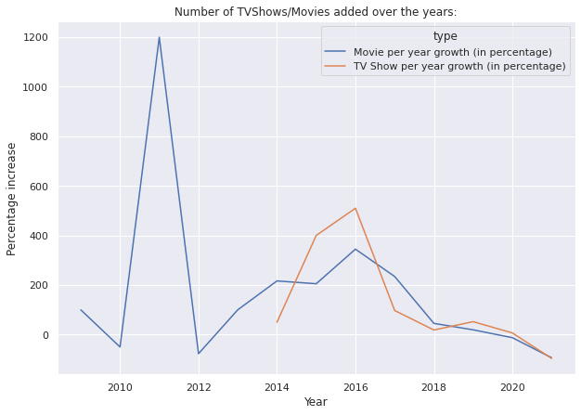

Slide 11
Insights:
In 2010-2011, the number of movies added to Netflix was increasing at greater pace, but starts decreasing after that or increase at lower pace.
Year 2014-2016 were good for TV shows.
But it will be wrong to say that the focus has been shifted to TV Shows

Slide 12
Understanding what type content is available in different countries
First we will try to understand the type of content available in different countries--- created dataframe 'country_type'
Then we understand the genres of content available in different countries--- created dataframe 'country_and_genre' and created a function 'country_genre' to extract all the genres available in that country.
Further created a function called 'welcome' which sum up all the items based on country and give user the list of content available on Netflix as per user specifications.

Slide 13
Clustering on the basis of text features:
Created a new dataframe with all features combined for pre-processing.
Text Pre-processing Steps:
Stopwords Removal: Stopwords are the words that are very frequent in conversations lioke pronouns. We remove the stopwords using nltk library.
Punctuation and special characters : Removed all the special character using re i.e. Regular Expressions library.
Stemming: Stemming is the process of converting inflecting for of words to its base words. Since, we didn’t require meaningful words therefore we opt stemming rather than lemmatization. Used PorterStemmer for this purpose.

Slide 14
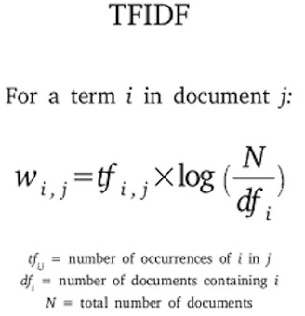
Tf-idf Vectorizer:
The process of transforming text into a vector is commonly referred to as text vectorization.
Tf-idf is a commonly used text vectorization technique available in sklearn library.
It gives the rare term high weight and gives the common term low weight.

Slide 15
Model-1 : Nearest Neighbors- Unsupervised Using cosine similarity metric:
First Model chosen to cluster the data was Nearest Neighbours- Unsupervised.
We used cosine similarity as our metric. The problem with other metric is that the value will start increasing as the number of features was of nearly 40,000. This was the same reason to not to apply K-means for clustering so as to avoid curse of dimensionality.
Created a function to display the top n recommendations based on cosine similarity.

Slide 16
Model – 2: Spectral Clustering
One problem with Kmeans is it is not able to understand the non-linear clusters. Thus, we used Spectral Clustering which is a kind of Kernelized k means.
Using Spectral clustering we cluster the groups into 10 clusters.
Using the labels we provide recommendations based on the contents belonging to same class.

Slide 17
Conclusion:
The platform’s interest on TV shows has increased but the growth of movies has not been affected.
The content is very less for the younger generations. The platform should try to incorporate content for all age groups to increase the customer count.
Also, the data should be further analysed with user preferences.
The recommendations can be done better using Content based and Collaborative Recommendations Engine.

Slide 18
Thank you

